Slide 1
20 Time Project
By: Ayesha Khan

Slide 2

The Premise of the Project
The Premise that was ultimately chosen for this project was to experience various types of projects and to expand my knowledge in various topics and subjects.
The Repositories created consisted of: - A weekly poetry repository - Design project (Total 2 projects) - Various stages of learning Korean - Weekly Log

Slide 3
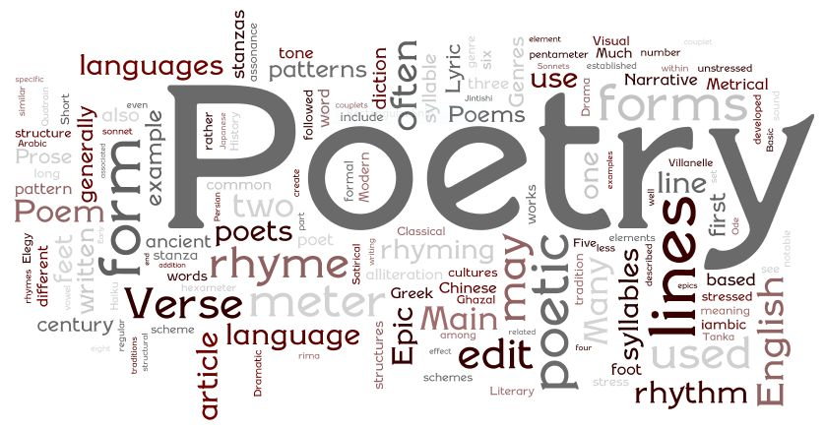
Repository 1: Poetry
In this repository I had intended to create and upload a new poem every week. The purpose behind this project was to look at a form of self expression that was different from what I would opt to.

Slide 4
Sample: Trust (an excerpt)
“It’s like the crust of a pie, Plain and dry, But it holds together everything that’s inside, Everything that we hide”

Slide 5

Repository 2: Wooden Design Pieces
There are a total of 2 projects that I worked on and documented.
The 1st: a piece I started by chance during my peer tutoring class
The 2nd: A piece that had been planned

Slide 6
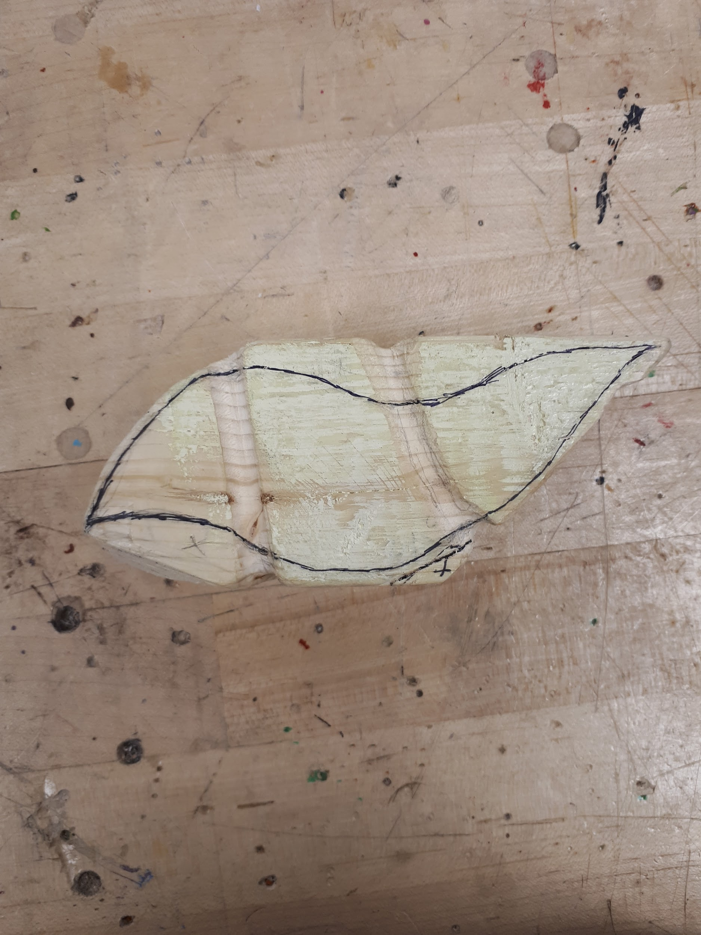
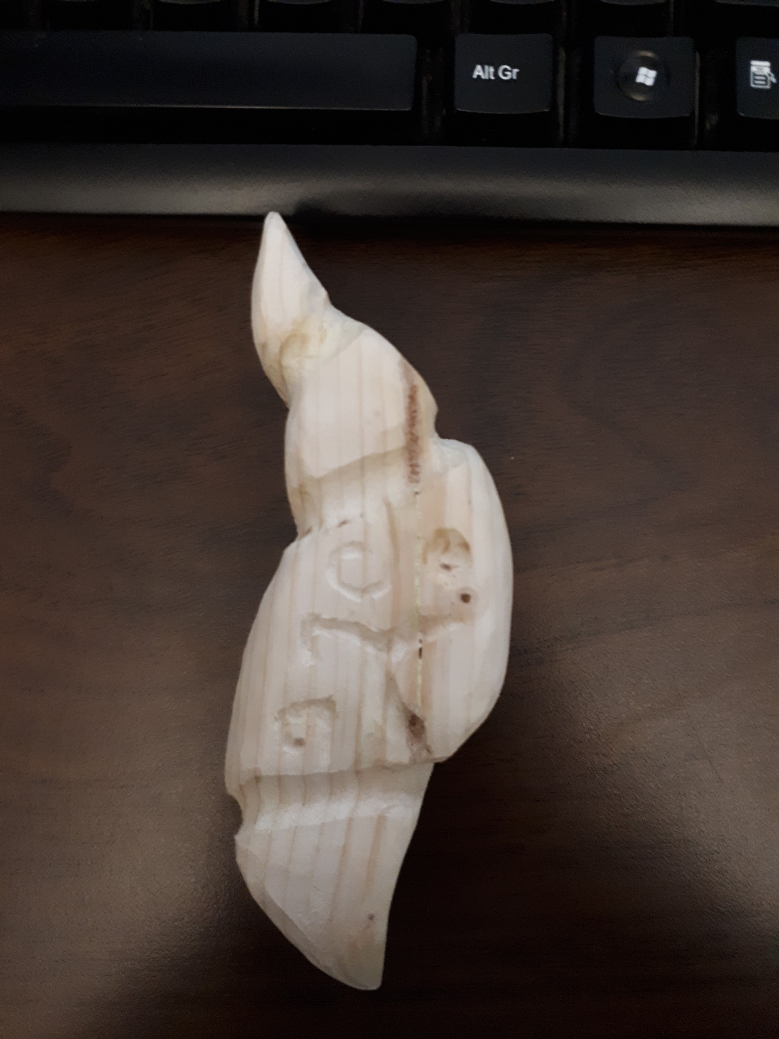
Piece 1:
This first piece I created by chance.
Start:
Finish:

Slide 7
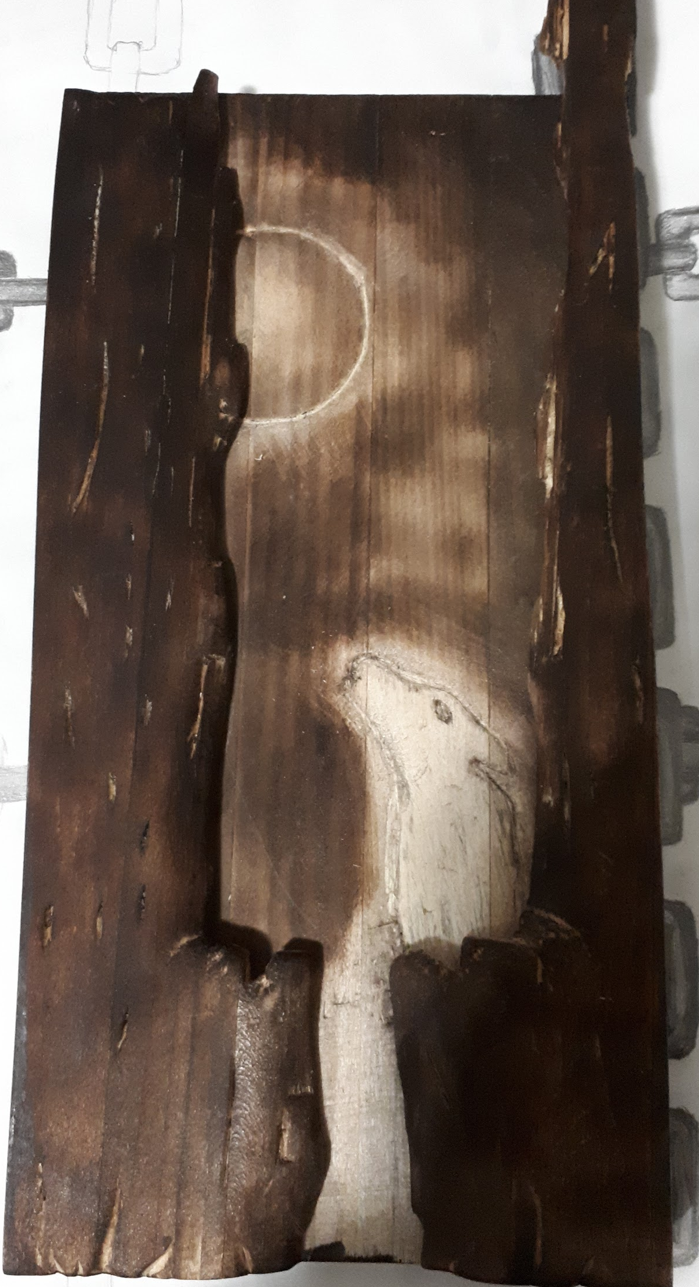
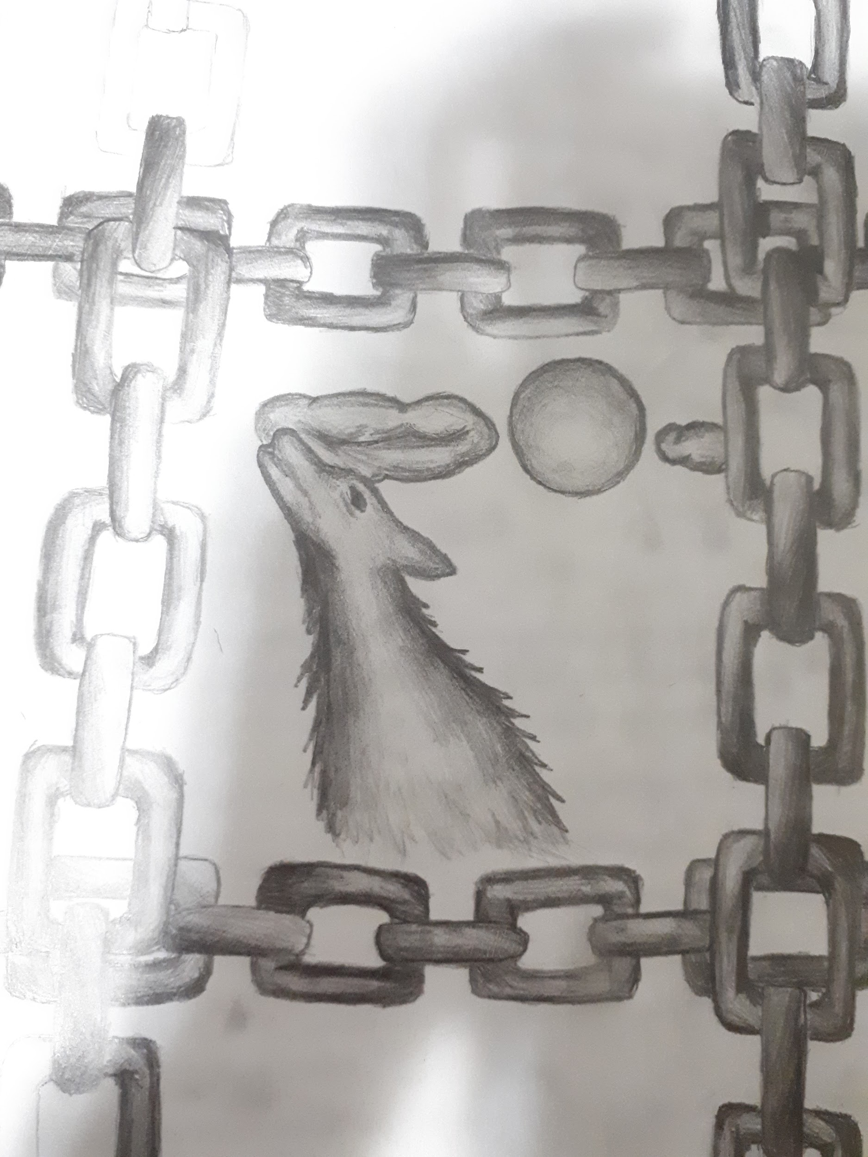
Piece 2:
This piece was based off of a sketch that I had drawn over the summer: It isn’t a masterpiece, but I’m happy that I was able to do as well as I did.

Slide 8
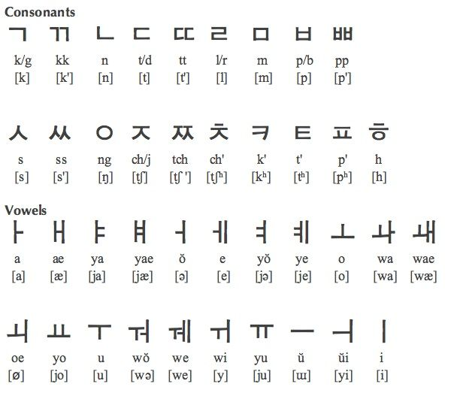
Repository 3: Learning How to Read Korean
I was able to get to the point where I know the alphabet and how to read it. I am unable to read fluently, I also can’t understand what’s written.

Slide 9
Cont.
I do know a few simple words, they’re however the most basic: (pronunciation)
Apple - 사과 (Sagwa) USA - 미국 (Migug) Banana - 바나나 (banana) China - 중국 (Jung-gug) me - 나는 (Naneun) Korea - 한국 (Hangug)

Slide 10

How it went:
Managing both school and working my way through the 20 time project was found to be fairly difficult.

Slide 11

The Experience?
The experience was enriching and the daily logs gave a sense of completion when looking back at them.

Slide 12
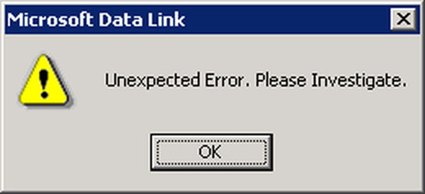
What Didn’t Work:
I often forgot to keep the logs up to date, also creating a poem every week is actually very difficult, and the creativity required when writing poems. After 6 poems I didn’t have any inspiration.

Slide 13
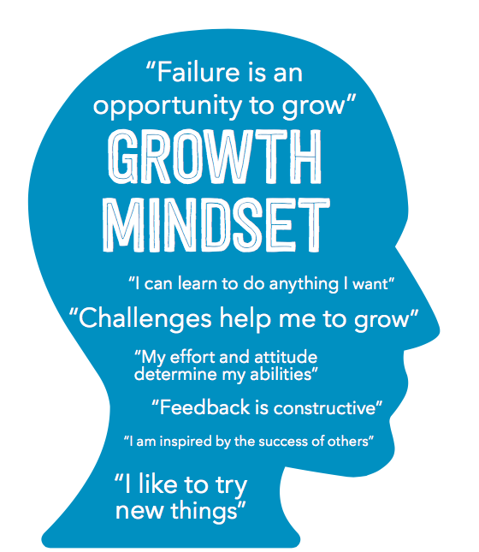
In The Future:
I intend to continue to learn Korean, and work on my skills when it comes to wood carving.

Slide 14
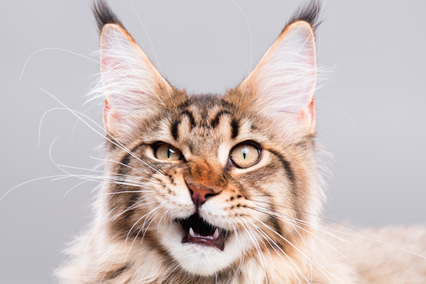
Thank You For Your Time!!

